Slide 1
My Ramadan Experience

Slide 2
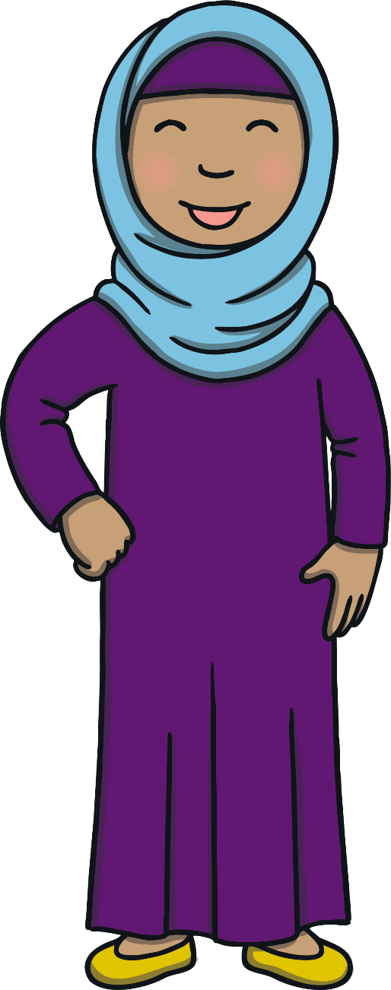
Hello. My name is Miss Guled. This is a very special time for my family because it is Ramadan. My family and I are Muslim. We are fasting for a month.

Slide 3
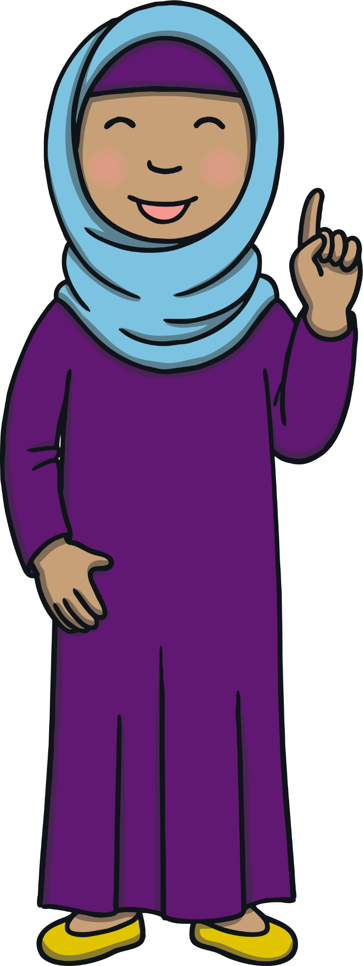
What Is Ramadan?
During Ramadan, grown-ups and older children do not eat when the sun is in the sky. This is called fasting.
We all eat a meal before the sun rise, called suhoor, and a meal when the sun sets, called Iftar.
I love Ramadan because I get to spend so much time with my family and I get to help and be kind to so many people.

Slide 4
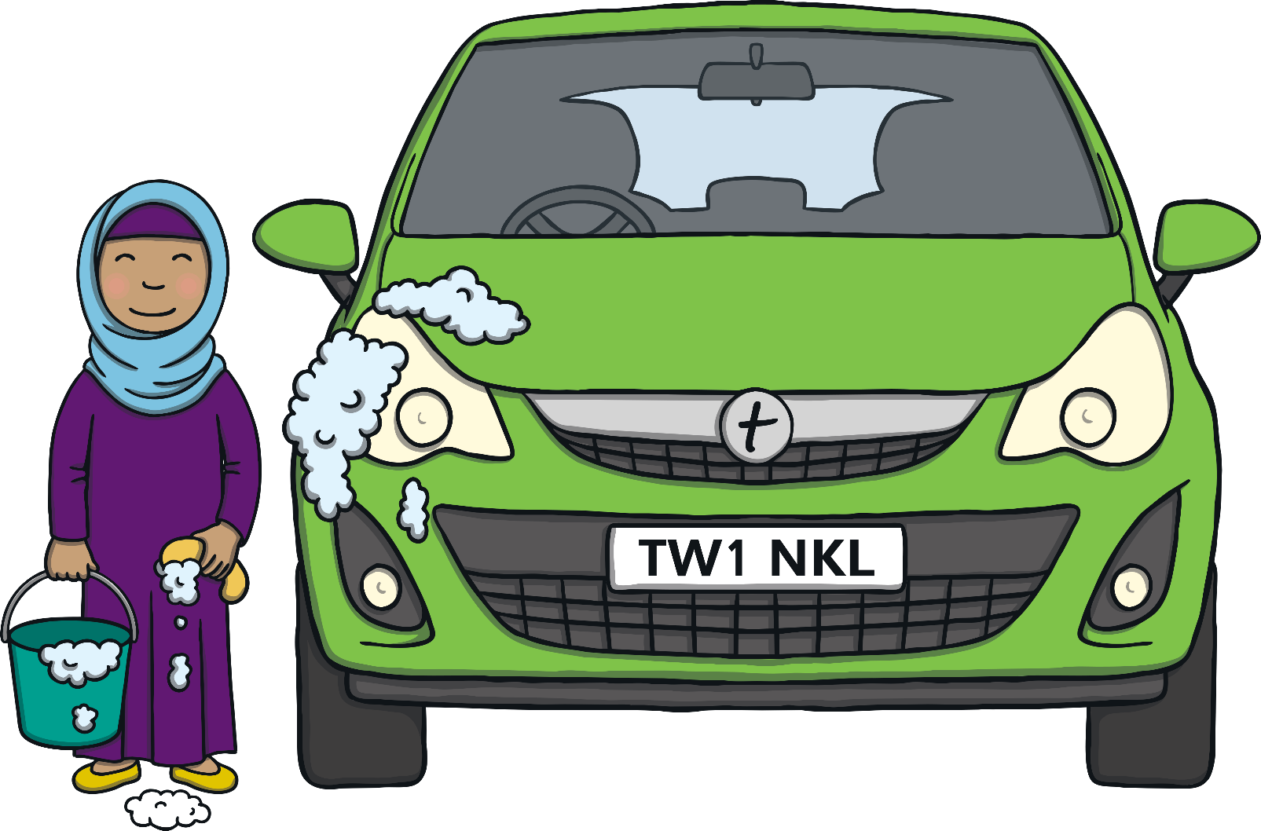
Being Kind
During Ramadan, I try to be really kind to other people. Everyday, I try to do a good deed. I try to help my parents or siblings. I also try to help my friends at Alma.
Today, I am helping my dad by cleaning his car.

Slide 5
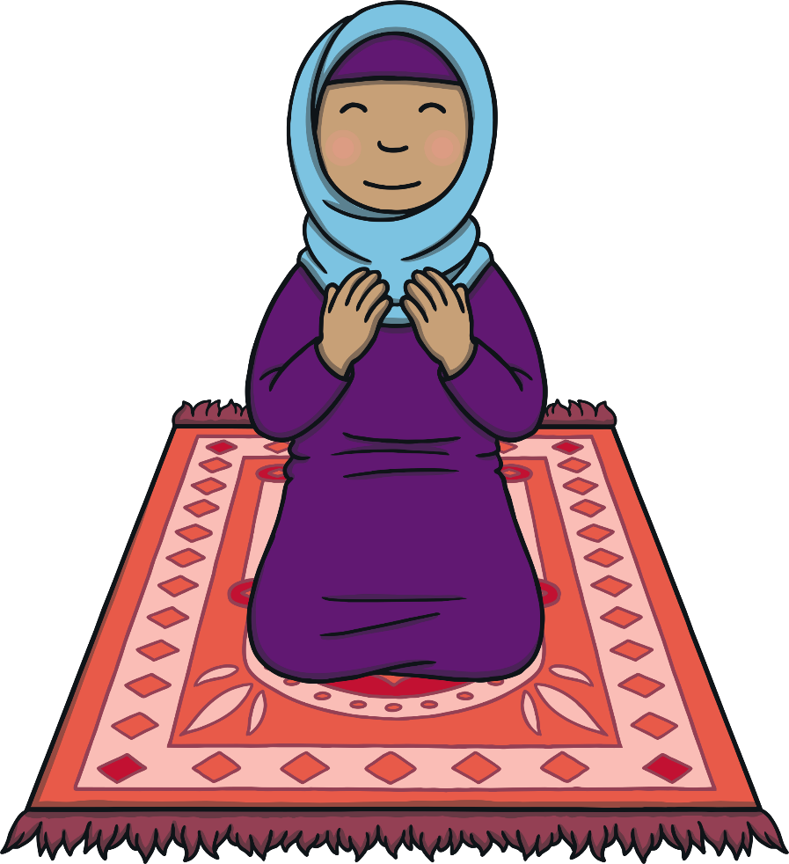
Prayer
During Ramadan, we pray more than normal. Sometimes, I pray at the Mosque and sometimes, I pray at home. We try read a lot of Quran (Holy Book) to remember Allah (God).
When we pray, we try to pray together as a community, so we go to the mosque nearly every night!

Slide 6
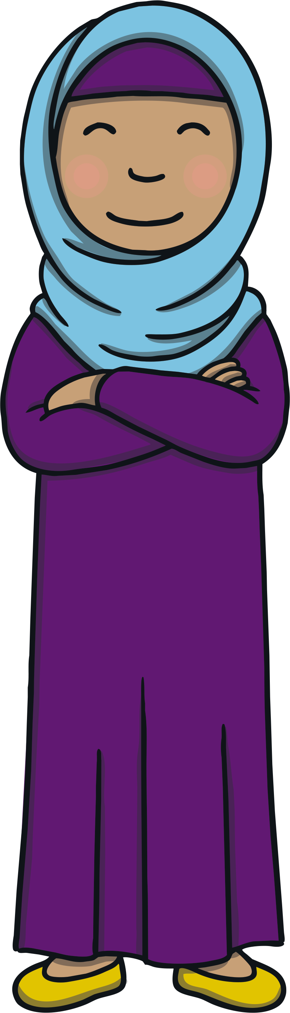
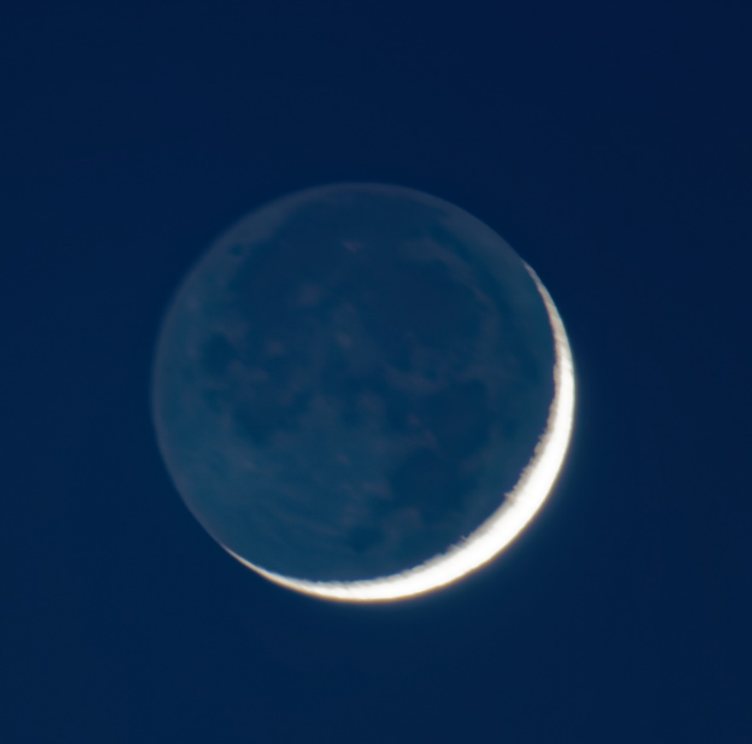
How Long Does Ramadan Last For?
When we spot the moon in mecca it is an exciting feeling. Do you know why?
Ramadan last for 29 or 30 days (1 month). We know that it is the end of Ramadan when a new crescent moon is spotted in the sky.

Slide 7
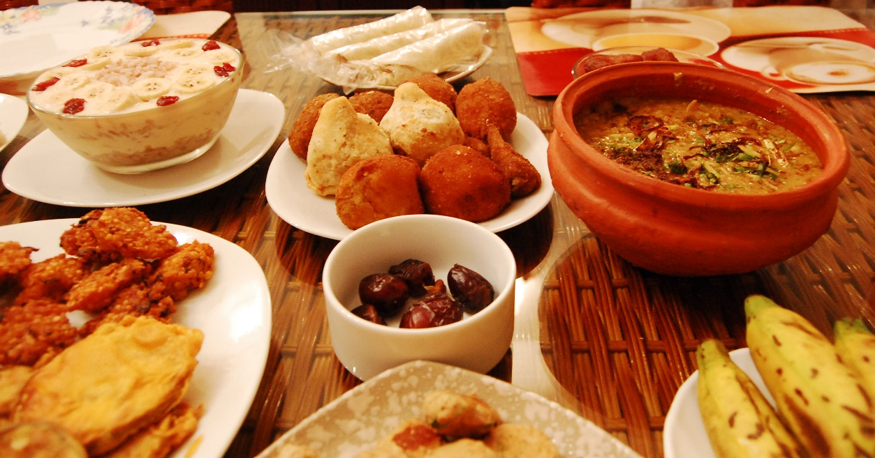

The new moon means Eid Al-Fitr
At the end of Ramadan, we have a big celebration, called Eid al-Fitr. We wear our best clothes and eat lots of yummy foods.
I everyone helps to cook food for our family and neighbors.
Eid Mubarak

